Slide 1
A Decade of Movies: Exploring Patterns in IMDB Data from 2006-2016
Ayan Choudhury
Date – 24.05.2023

Slide 2
Table of contents
01
02
03
04
05
Introduction
About Data
Objective
Graphical representation and analysis
interpretation

Slide 3
Let’s start

Slide 4
01
Introduction
c

Slide 5

Satyajit Ray, one of the greatest filmmakers of all time. was an Indian director, screenwriter, documentary filmmaker.
Ray was born in Calcutta on May 2, 1921.
Ray directed a total of 36 films, including feature films, documentaries, and shorts.
His first film, "Pather Panchali" (1955), won numerous international awards, including the Best Human Document award at the 1956 Cannes Film Festival. It is part of The Apu Trilogy, along with "Aparajito" (1956) and "Apur Sansar" (The World of Apu) (1959).

Slide 6


Two best scene from PATHER PANCHALI

Slide 7
1. Cinema is the art of making movies, using visuals, sound, and storytelling to tell stories or express ideas.
2. It is a popular form of entertainment and communication that plays a significant role in modern culture.
3. Movies or films are created through the combination of visuals, sound, and narrative, capturing the attention and imagination of audiences.
4. Cinema offers various advantages to society, such as providing a means of escapism, fostering creativity and inspiration, and promoting cultural understanding.
5. It has become an integral part of our lives, bringing people together, sparking conversations, and leaving a lasting impact on individuals and communities.

Slide 8
02
About Data

Slide 9
The IMDb movie dataset contains information about the top 1,000 most popular movies on IMDb from 2006 to 2016. It consists of 1,000 rows (instances) and 11 columns (attributes). The dataset includes both quantitative and qualitative attributes, with 5 quantitative attributes and 6 qualitative attributes.
The quantitative attributes include:
Title: The name of the movie.
Genre: The classification of the movie based on the genres it belongs to.
Description: A brief summary of the movie's plot in one sentence.
Director: The person who directed the film.
Actors: The main stars of the movie.
The qualitative attributes include:
Year: The year the movie was released, represented as an integer.
Runtime (Minutes): The duration of the movie in minutes.
Rating: A user-rated score ranging from 0 to 10.
Votes: The number of votes the movie has received.
Revenue (Millions): The total box office earnings of the film in millions.
Metascore: An aggregate average of critic scores ranging from 0 to 100, where higher scores indicate positive reviews.

Slide 10
03
Objectives

Slide 11
1] The genre of a movie can affect how popular it becomes over a long period of time and how much money it makes.
2] Do well-rated movies, based on critics and users (general public reviews) earn better revenue?
3] Do critics and audiences have similar opinions on what makes a good movie?

Slide 12
04
Graphical representation and analysis

Slide 13
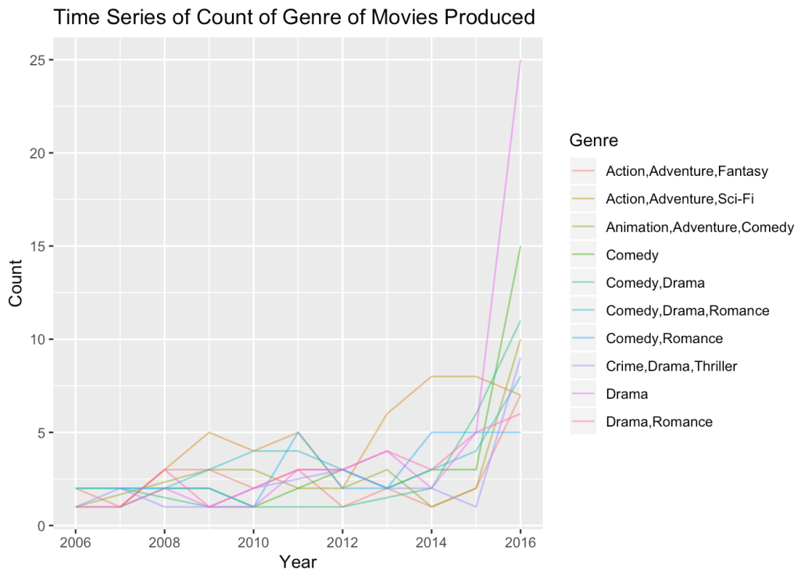
We observed a noticeable rise in the production of movies Action, Adventure, Sci-Fi movies

Slide 14
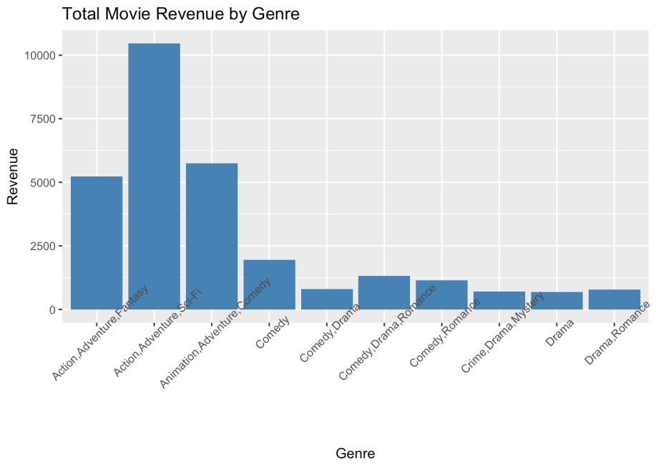
Based on our analysis, the Action, Adventure, Sci-Fi genre seems to generate the highest revenue

Slide 15
We divided the revenue data into two parts, adventure and non adventure.
we utilized a two-sample t-test to compare the mean performance of adventure movies to that of movies not in the adventure genre.
I got a very small p-value (p =1.9e-08), which is lower than our predetermined significance level of 0.05. Therefore, we reject the null hypothesis that the means of revenue for adventure movies and non-adventure movies are equal.
The means of revenue for adventure movies and non-adventure movies are not equal.

Slide 16
Based on our findings, it can be inferred that adventure movies have a higher gross revenue than all other genres, as both our statistical analysis and graph indicate. It is noteworthy that the production of adventure movies has increased recently, as revealed by our initial graph.

Slide 17
Objective 2
Do well-rated movies, based on critics and users (general public reviews) earn better revenue?

Slide 18
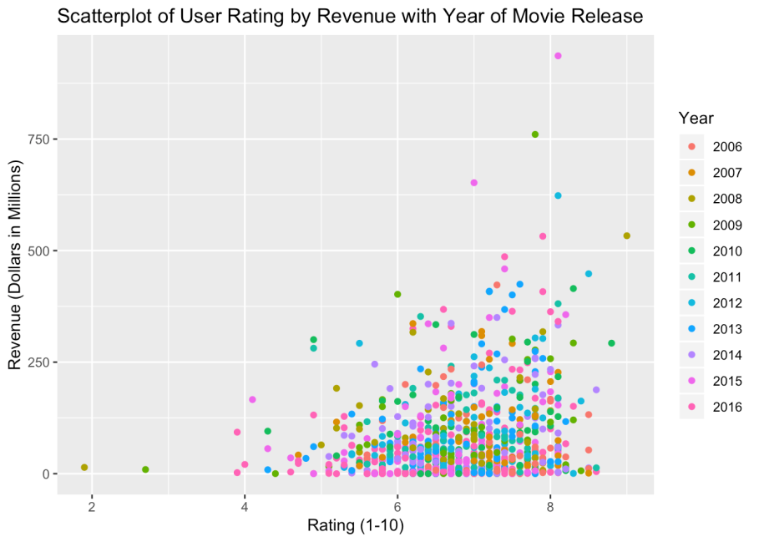
It seems that if the movie is generally rated higher, then it has the possibility of making more in the box office.

Slide 19
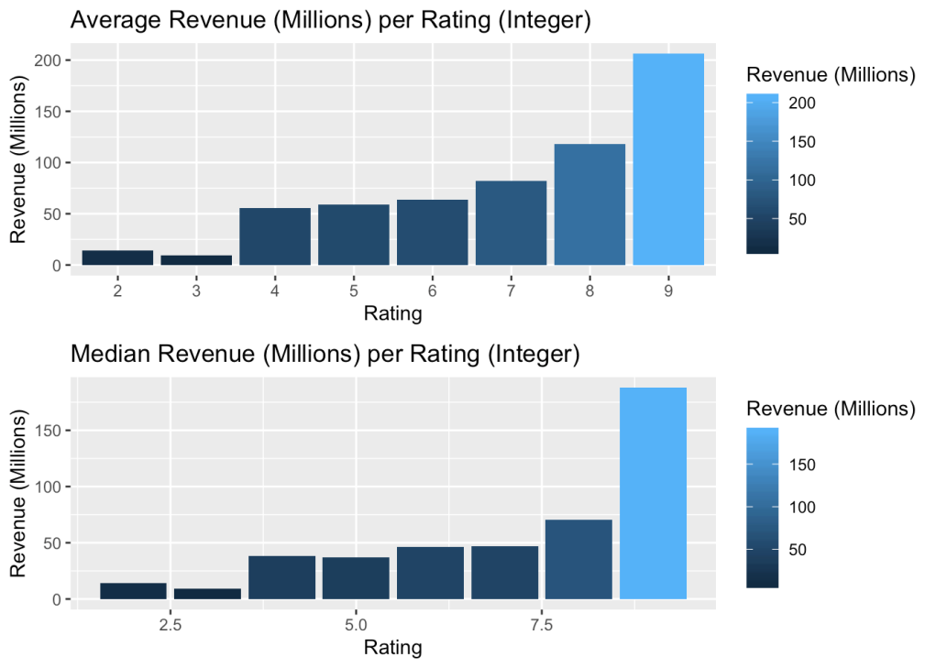
the average revenue and the median revenue increase with the increase of the rating.

Slide 20
To investigate the correlation between ratings and revenue, we performed linear regression.
Based on our analysis using linear regression, we found that both the p-values of the coefficients and the fstatistic are less than our chosen significance level of 0.05. This leads us to reject the null hypothesis, which assumes that there is no significant relationship between the rating and the revenue (in millions).
we can conclude that there is a relationship between these two variables.

Slide 21
we can use the ANOVA test to analyze variance and determine if there is a significant difference in mean revenues between the different rating categories.
The p-value is less than 0.05, indicating that there is a statistically significant difference in revenues between at least one of the rating groups.
Therefore, we can infer that there exists a relationship between the rating of a movie and its revenue(million).

Slide 22

With movie review websites, it's easy to get a sense of what others are thinking about a particular film. Similarly, social media platforms such as Facebook and Instagram can provide insight into how our friends are responding to new releases.
positive user ratings drive us to the theaters, while negative ones may deter us.

Slide 23
Objective 3
Do critics and audiences have similar opinions on what makes a good movie?

Slide 24
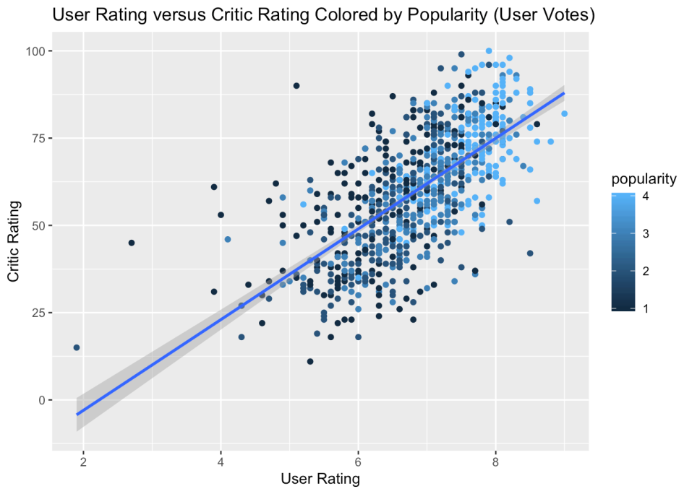
it seems that movies with higher ratings tend to receive more ratings from users.

Slide 25
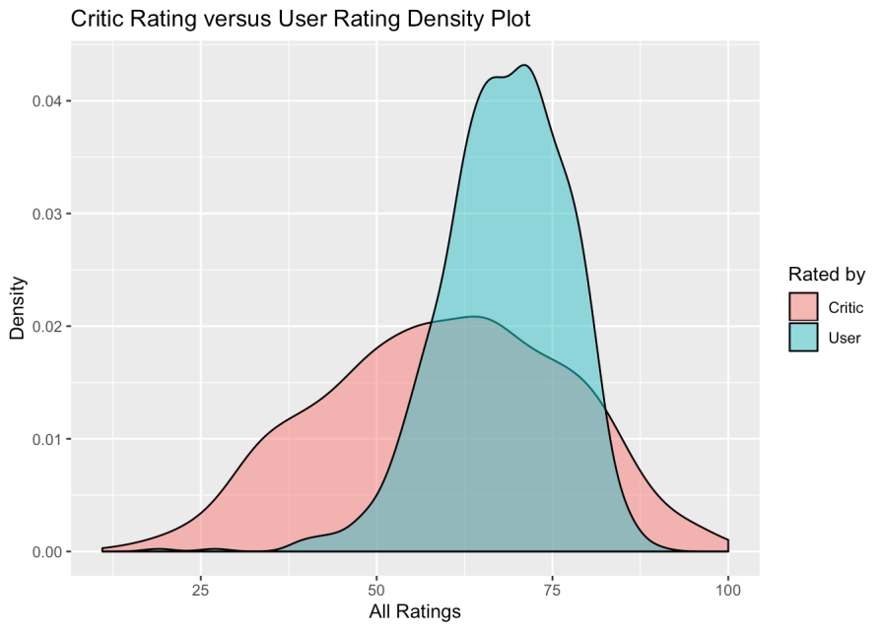
Users generally give ratings in a similar range, while critics' ratings vary more widely. Critics have a peak around the 60s, while users' ratings cluster around the 70s. Both distributions are mostly normal.

Slide 26
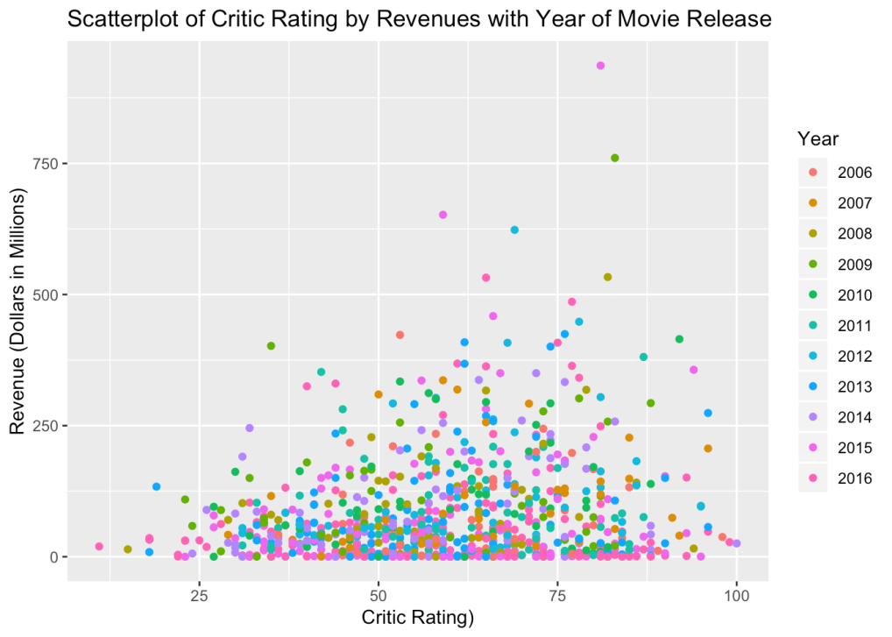
The plot shows that a high critic rating (Metascore) doesn't always lead to high revenue. Surprisingly, some poorly reviewed movies performed better in terms of revenue than highly reviewed ones.
User ratings are more important than critic ratings for predicting box office success.

Slide 27
To check that the user rating data follows normal distribution or not, we performed Shapiro-Wilk test in R. And the p-value is 5.697e-11. So the data does not follows normal distribution. To assess whether the distribution of critic ratings and user ratings are similar, we conducted a two-sample Kolmogorov-Smirnov test.
The results of the Kolmogorov-Smirnov test indicate that the distributions of critic ratings and user ratings are significantly different. The p-value obtained (p-value < 2.2e-16) is much smaller than our chosen level of significance (0.05), which led us to reject the null hypothesis that the two distributions are the same.

Slide 28

Critics are looking for different things in a movie than the general public. Critics may be more interested in the movie's artistic merit.
Users may be more interested in its entertainment value.

Slide 29
Final conclusion
Adventure and action movies are the most popular genre.
User ratings are more important than critic ratings for predicting box office success.
The distribution of critic and user ratings is not the same.
It is more important to please the general public than critics.

Slide 30
References
Notes and pdf from
dr. Sudhanshu S. Maity,
dr. Saran Ishika Maiti,
dr. Soumalya Mukhopadhyay,
dr. Sourav rana
kaggle.com,
wikipedia,
google.

Slide 31
Thank You

